Slide 1
AMEX AI/ML HACKATHON
GEEK GODDESS 2021
TEAM - FLY HIGH

Slide 2
TABLE OF CONTENTS
01
02
03
04
05
06
07
08
09
Problem Statement
Data Description
Exploratory Data Analysis
Pre Processing
Feature Engineering
Performance Metric
Implementation
Comparative Study
Choice of Model

Slide 3
01
PROBLEM
STATEMENT

Slide 4
PROBLEM STATEMENT
We are given the data of direct marketing campaigns (phone calls) of a banking institution. The classification goal is to predict if the client will subscribe a term deposit (target variable y).
The task is to implement a Bank Term Deposit Scheme. The technique is phone calling the clients, getting their details and letting them know about the different schemes. The data sets are provided with the details of the campaign to train our model.
The purpose of the hackathon is to build a model which would predict if the client will say ‘yes’ or ‘no’ for the scheme.

Slide 5
02
DATA DESCRIPTION

Slide 6
Bank Client Data:
AGE
DEFAULT
(numeric)
(has credit in default?)
JOB
(type of job)
HOUSING
MARITAL
(has housing loan?)
(marital status)
LOAN
(has personal loan?)
EDUCATION
(person’s education)

Slide 7
Related with the last contact of the current campaign:
CONTACT
MONTH
(categorical-’celular’)
(categorical)
DAY OF WEEK
DURATION
(categorical)
(numeric (in seconds))

Slide 8
Other Attributes:
CAMPAIGN
P DAYS
(numeric)
(numeric)
PREVIOUS
POUTCOME
(numerical)
(categorical)

Slide 9
Social and Economic Context Attributes
emp.var.rate
euribor3m
(numeric)
(numeric)
cons.price.idx
nr.employed
(numeric)
(numeric)
cons.conf.idx
(numeric)

Slide 10
03
EXPLORATORY DATA ANALYSIS

Slide 11
It is not a good idea to get into the modelling phase without first learning about the problem. So, to begin, we'll conduct some EDA (Exploratory Data Analysis) to learn more about the type of data we're dealing with and whether there is any pattern in the data.

Slide 12
UNIVARIATE ANALYSIS
“Uni” means “one”, so in other words it means the analysis using only a single variable. It's major purpose is to describe; It takes data, summarizes that data and finds patterns in the data.
We'll use univariate analysis to see which features can aid us with our classification problem and which variables aren't so crucial.
As it will be very lengthy to depict the analysis of all the twenty features, we will look at only some key features and their analysis.

Slide 13
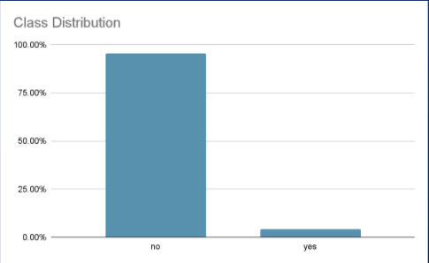
CLASS DISTRIBUTION OF OUTPUT VARIABLE
Negative class is 95.6% where as positive class is 4.4%
We can infer that since are dataset is imbalanced, ROC AUC performance metric should be used
Only if both the TPR and FPR are well above the random line in the ROC curve, we will get a good AUC.
We can see from the above plot that the dataset in imbalanced, where the number of negative class is much more than the number of positive class

Slide 14
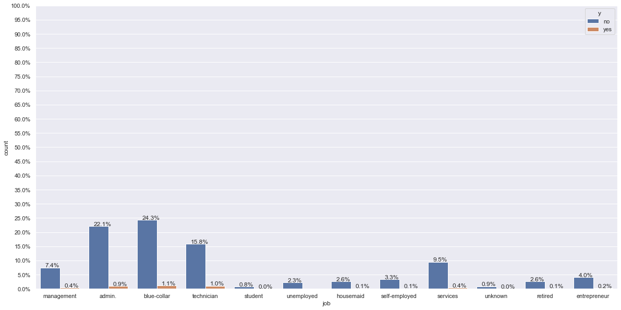
CLASS DISTRIBUTION OF CATEGORICAL FEATURE JOB
Blue-collar jobs are highest to subscribe but they are also highest to unsubscribe.
This is due to the fact that we have more customers who work as blue-collar assistants than any other occupation.

Slide 15
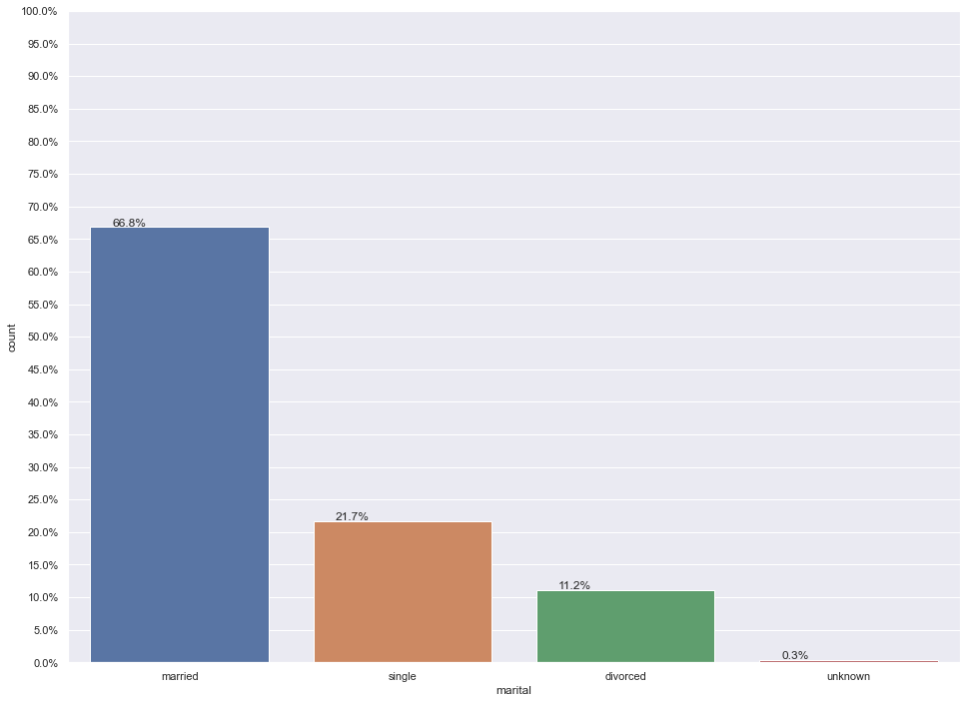
CLASS DISTRIBUTION OF CATEGORICAL FEATURE MARITAL
The majority of consumers are married couples. Single, divorced, and unknown came in second and third, respectively.

Slide 16
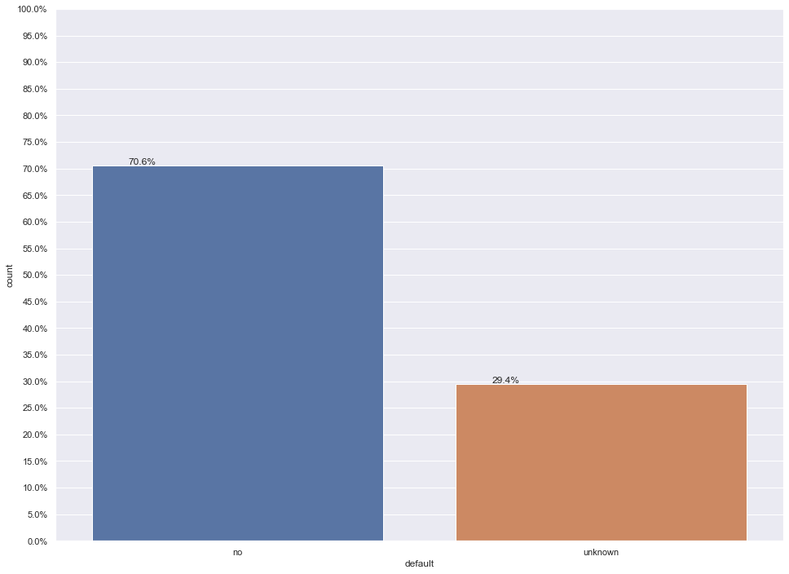
CLASS DISTRIBUTION OF CATEGORICAL FEATURE DEFAULT
The majority of consumers have the value of default feature as ‘no’. There is no data in the training set with default feature value ‘yes’.

Slide 17
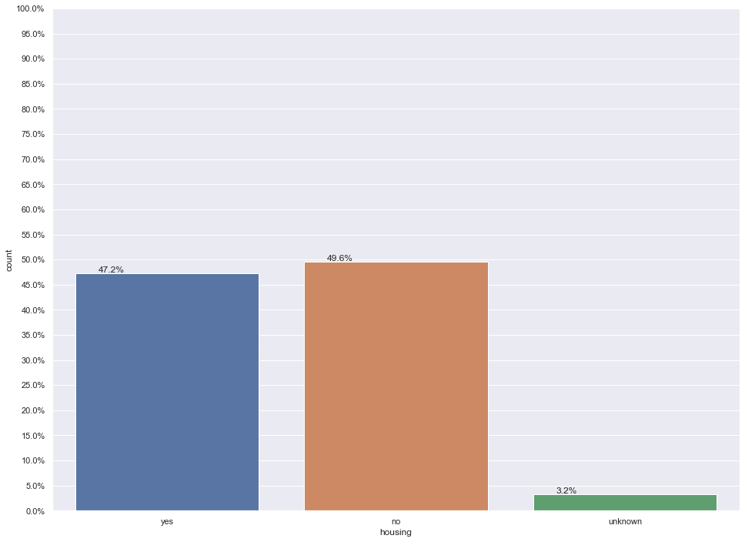
CLASS DISTRIBUTION OF CATEGORICAL FEATURE HOUSING
An equivalent number of customers have and do not have a housing loan according to our training dataset.

Slide 18
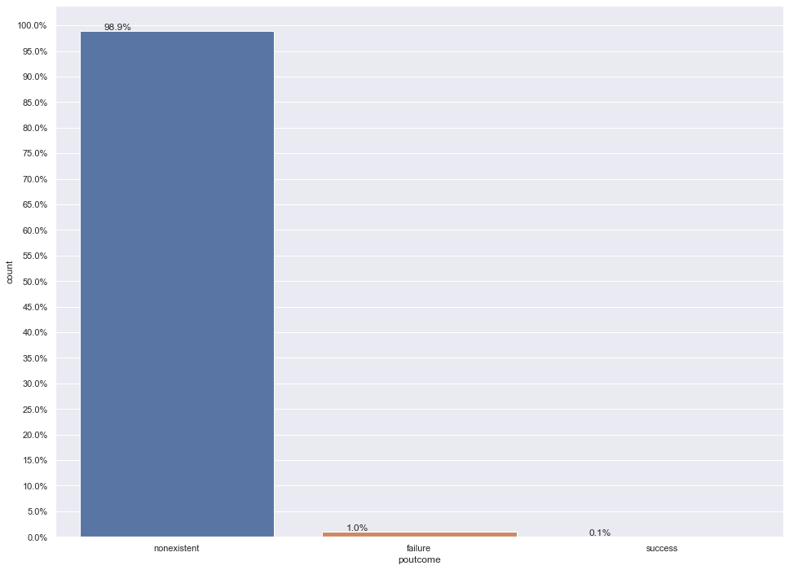
CLASS DISTRIBUTION OF CATEGORICAL FEATURE POUTCOME
The majority of clients are unaware of the preceding marketing campaign's outcome.
It signifies that the majority of the clients are new to the company and have never been contacted before.

Slide 19
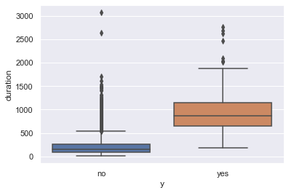
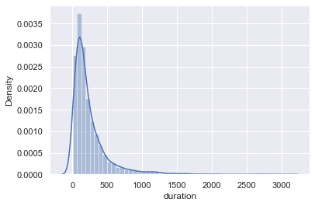
UNIVARIATE ANALYSIS OF FEATURE DURATION
This attribute highly affects the output target (e.g., if duration=0 then y=’no’)
From the plot it is clear that, the duration (last contact duration) of a customer can be useful for predicting the target variable.

Slide 20
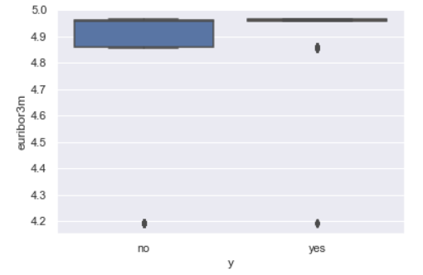
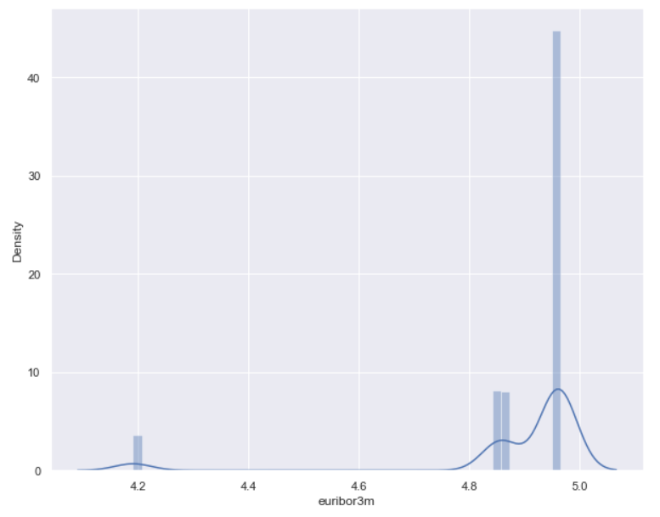
UNIVARIATE ANALYSIS OF FEATURE EURIBOR3M
From the above plot, we can clearly see the difference in median for both the classes.
This indicates that the feature can be very useful for our case study.

Slide 21
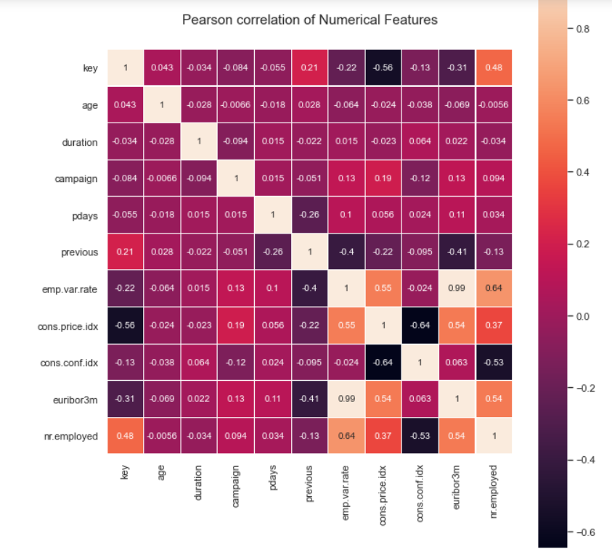
CORRELATION MATRIX OF NUMERICAL FEATURES
0.99
Correlation is a statistical measure that determines how closely two or more variables fluctuate.
euribor3m and emp.var.rate have highest correlation of 0.99
A positive correlation suggests that the variables are increasing or decreasing in lockstep; a negative correlation indicates that one variable is increasing while the other is decreasing.

Slide 22
04
PRE PROCESSING

Slide 23
REMOVING THE KEY FEATURE
We remove the key series from our training dataset as it stores numerical values which are of no use in training our model.
If we will not remove the key feature then during training of our model, the classifier will treat key as a numerical input feature which will affect our output values y.

Slide 24
05
FEATURE ENGINEERING

Slide 25
DEALING WITH MISSING VALUES
In our dataset, there are no missing values. If there were missing values, we would have removed the row corresponding to the missing values or we would have used imputation to deal with the missing values.

Slide 26
DEALING WITH DUPLICATE VALUES
SEPARATING INDEPENDENT AND CLASS VARIABLES
In our dataset, we have no duplicate values. If there were duplicate values, we would have removed them.
We separate the input features with the output y by creating X_train and y.

Slide 27
SPLITTING THE DATA
We split the data into training set and cross validation set. Cross-validation is to use a small sample to assess how the model will perform in general when used to generate predictions on data that was not utilised during the model's training. This prevents overfitting of data.

Slide 28
CATEGORICAL FEATURES
Categorical features means features which can take on values from a limited set of values. It represents the types of data which is divided into groups.
Our data contains 10 categorical variables. These are as follows :
Job Marital
Education Default
Housing Loan
Contact Month
Day of the week Poutcome

Slide 29
ONE HOT ENCODING
Machine learning models require all input and output variables to be numeric. This means that if your data contains categorical data, you must encode it to numbers before you can fit and evaluate a model. We will look at one hot encoding.
For each unique category it creates a separate column with binary values (0 or 1). In each of these new columns there is a value of 1 if the corresponding category is present in this row and 0 otherwise.
To encode the categorical variables, we use CountVectorizer which is normally used for encoding text features into Bag Of Words (BoW) representation.
A difficulty emerges because, after dividing the data into train and test datasets, some categories of features may appear in the train dataset but not in the test dataset. On the train dataset, we use CountVectorizer and fit_transform, and on the cv dataset, we utilise transform.

Slide 30
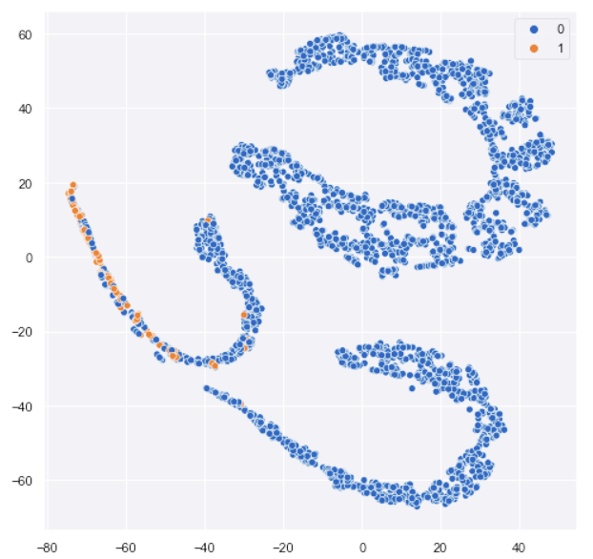
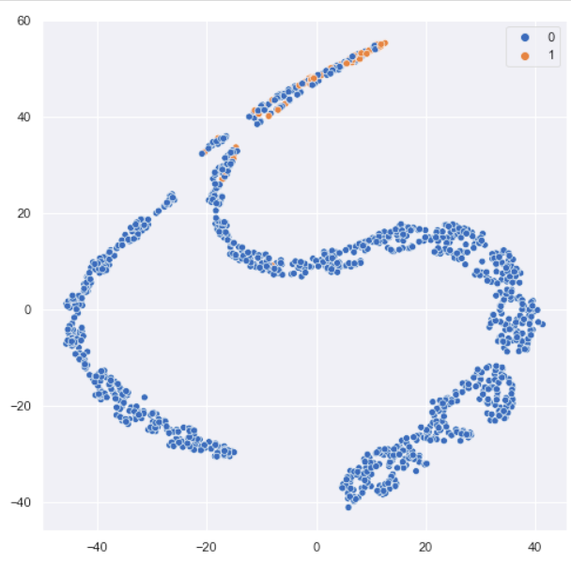
VISUALIZE THE DATA USING T-SNE PLOT
After encoding the categorical variable, we visualize the higher dimensional data using the T-SNE plot.
Training
Cross validation

Slide 31
06
PERFORMANCE
METRIC

Slide 32
The performance metric used for this case study is AUC ROC score also known as AUROC (Area Under the Receiver Operating Characteristics).

Slide 33
Because of this, we have chosen AUC over accuracy.
The dataset we're working with is imbalanced, as we'll see in Exploratory data analysis, with the class "no" being the majority.
Any random model can give us very good accuracy if we use accuracy as our metric. In the end, though, it will be a random model.
AUC overcomes this issue by examining both the True positive rate (TPR) and the False positive rate (FPR).

Slide 34
07
IMPLEMENTATION

Slide 35
METHODOLOGY AND IMPLEMENTATION
We propose various classifiers to train our model, check the AUC ROC score in each one of them and then choose the one with the best AUC RUC score.

Slide 36
HYPERPARAMETER TUNING
When creating a machine learning model, you'll be presented with design choices as to how to define your model architecture. Often times, we don't immediately know what the optimal model architecture should be for a given model, and thus we'd like to be able to explore a range of possibilities.
Parameters which define the model architecture are referred to as hyperparameters and thus this process of searching for the ideal model architecture is referred to as hyperparameter tuning.
For each algorithm we used to train our model, we first tune the hyperparameters and then used the model architecture to get the most optimised solution.

Slide 37
Logistic Regression
We used sklearn’s LogisticRegression class to train our model.
This class implements regularized logistic regression using the ‘lbfgs’ solver.
‘lbfgs’ solvers support only L2 regularization.
We tune the 'C' hyperparameter. A large value of C tells the model to give the training data a lot of weight and the complexity penalty a lot of weight. A low value instructs the model to prioritise this complexity penalty above fitting to the training data.
A high C value suggests "trust this training data a lot," whereas a low value means "this data may not be fully reflective of real-world data, therefore don't listen to it if it tells you to make a parameter particularly large."

Slide 38
OUR PROCESS
STEP 2
STEP 4
STEP 1
STEP 3
STEP 5
We first iterate through all the choices of hyperparameter ‘C’. We train our model for each choice of ‘C’ and fit the training set with our model.
We predict ROC AUC score for each calibrated classifier and choose the value of ‘C’ that gives the largest ROC AUC score.
Choice of C =
[10⁻⁵, 10⁴]
We calibrate the model using CalibratedClassifier with sigmoid method of calibration. Then for each of these calibrated models corresponding to our choice of ‘C’, we predict the probabilities of output variable ‘y’.
We train our model again using the best value of C and predict the most optimal probabilities of output variable ‘y’.

Slide 39
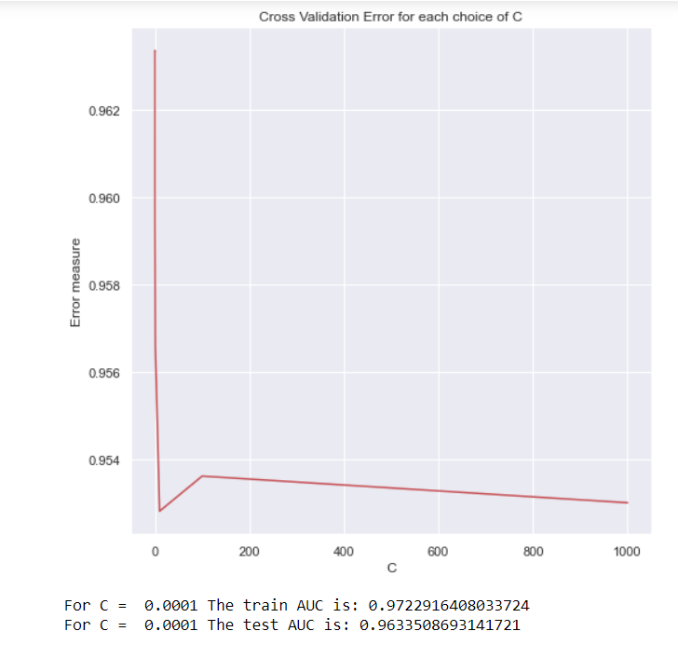
OUTCOME
The best choice of ‘C’ used in our most optimized Logistic Regression model architecture is C = 0.0001
The AUC score on the cross validation set is 0.9633

Slide 40
kNN (k- Nearest Neighbors)
An object is classified in k-NN classification by a majority vote of its neighbours, with the object being allocated to the most common class among its k closest neighbours.
We used sklearn’s KNeighborsClassifier to train our model for classification using k nearest neighbors algorithm. Classification task is performed on our one hot encoded dataset.
We tune the number of nearest neighbors hyperparameter for best roc_auc_score.

Slide 41
OUR PROCESS
STEP 2
STEP 4
STEP 1
STEP 3
STEP 5
We first iterate through all the choices of hyperparameter ‘n_neighbors’. We train our model using KNeighborsClassifier for each choice of ‘n_neighbors’ and fit the training set with our model.
We predict ROC AUC score for each calibrated classifier and choose the value of ‘n_neighbors’ that gives the largest ROC AUC score.
Choice of n_neighbors = [1, 31]
We calibrate the model using CalibratedClassifier with sigmoid method of calibration. Then for each of these calibrated models corresponding to our choice of ‘n_neighbors’, we predict the probabilities of output variable ‘y’.
We train our model again using the best value of ‘n_neighbors’ and predict the most optimal probabilities of output variable ‘y’.

Slide 42
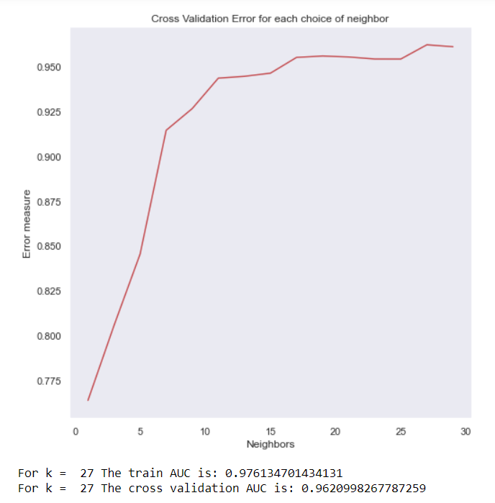
OUTCOME
The best choice of ‘n_neighbors’ used in our most optimized KNN Classification model architecture is n_neighbors = 27
The AUC score on the cross validation set is 0.9620

Slide 43
LINEAR SVM
Linear SVM is used for linearly separable data. This estimator uses stochastic gradient descent (SGD) learning to create regularised linear models: the gradient of the loss is estimated one sample at a time, and the model is updated along the way with a decreasing strength schedule (aka learning rate).
We use sklearn’s SGDClassifier to train our model by using Linear SVM Algorithm. Classification task is performed on our one hot encoded training dataset.
We tune the hyper parameter alpha, which is multiplied by the regularization term. Higher the alpha, higher the penalization or regularization.

Slide 44
OUR PROCESS
STEP 2
STEP 4
STEP 1
STEP 3
STEP 5
We first iterate through all the choices of hyperparameter ‘alpha’. We train our model using SGDClassifier for each choice of ‘alpha’ and fit the training set with our model.
We predict ROC AUC score for each calibrated classifier and choose the value of ‘alpha’ that gives the largest ROC AUC score.
Choice of alpha = [10⁻⁵, 10⁴]
We calibrate the model using CalibratedClassifier with sigmoid method of calibration. Then for each of these calibrated models corresponding to our choice of ‘alpha’, we predict the probabilities of output variable ‘y’.
We train our model again using the best value of ‘alpha’ and predict the most optimal probabilities of output variable ‘y’.

Slide 45
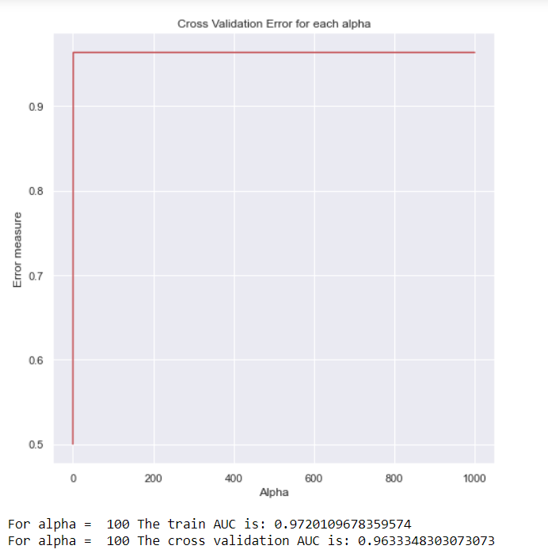
OUTCOME
The best choice of ‘alpha’ used in our most optimized Linear SVM model architecture is alpha = 100
The AUC score on the cross validation set is 0.9633

Slide 46
Support Vector Classification
The objective of a Linear SVC (Support Vector Classifier) is to fit to the data we provide, returning a "best fit" hyperplane that divides, or categorizes, your data. From there, after getting the hyperplane, we can then feed some features to your classifier to see what the "predicted" class is.
We perform the task of classification on the one hot encoded dataset using Support Vector Classification using RBF kernel.
We tune the hyperparameter 'C' to avoid overfitting and obtain better results.

Slide 47
OUR PROCESS
STEP 2
STEP 4
STEP 1
STEP 3
STEP 5
We first iterate through all the choices of hyperparameter ‘C’. We train our model using SVC for each choice of ‘C’ and fit the training set with our model.
We predict ROC AUC score for each calibrated classifier and choose the value of ‘C’ that gives the largest ROC AUC score.
Choice of C = [10⁻⁵, 10⁴]
We calibrate the model using CalibratedClassifier with sigmoid method of calibration. Then for each of these calibrated models corresponding to our choice of ‘C’, we predict the probabilities of output variable ‘y’.
We train our model again using the best value of ‘C’ and predict the most optimal probabilities of output variable ‘y’.

Slide 48
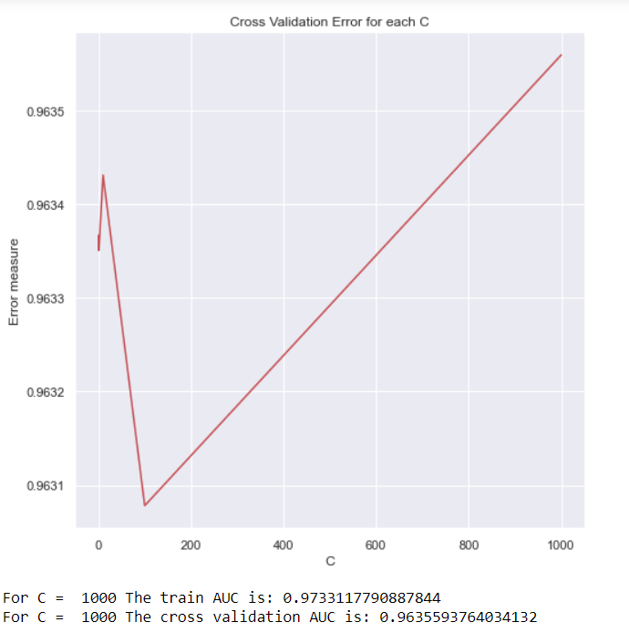
OUTCOME
The best choice of ‘C’ used in our most optimized SVC model architecture is C = 1000
The AUC score on the cross validation set is 0.9635

Slide 49
Random Forest
A random forest is a meta estimator that employs averaging to increase predicted accuracy and control over-fitting by fitting a number of decision tree classifiers on various sub-samples of the dataset.
We implemented random forest algorithm on the one hot encoded training dataset by using RandomForestClassifier from sklearn.ensemble provided by scikit-learn.
We tune the hyper parameters n_estimators which governs the number of trees in the forest.

Slide 50
OUR PROCESS
STEP 2
STEP 4
STEP 1
STEP 3
STEP 5
We first iterate through all the choices of hyperparameter ‘n_estimators’. We train our model using RandomForestClassifier for each choice of ‘n_estimators’ and fit the training set with our model.
We predict ROC AUC score for each calibrated classifier and choose the value of ‘n_estimators’ that gives the largest ROC AUC score.
Choice of n_estimators = [10,50,100,500,1000,2000,3000]
We calibrate the model using CalibratedClassifier with sigmoid method of calibration. Then for each of these calibrated models corresponding to our choice of ‘n_estimators’, we predict the probabilities of output variable ‘y’.
We train our model again using the best value of ‘n_estimators’ and predict the most optimal probabilities of output variable ‘y’.

Slide 51
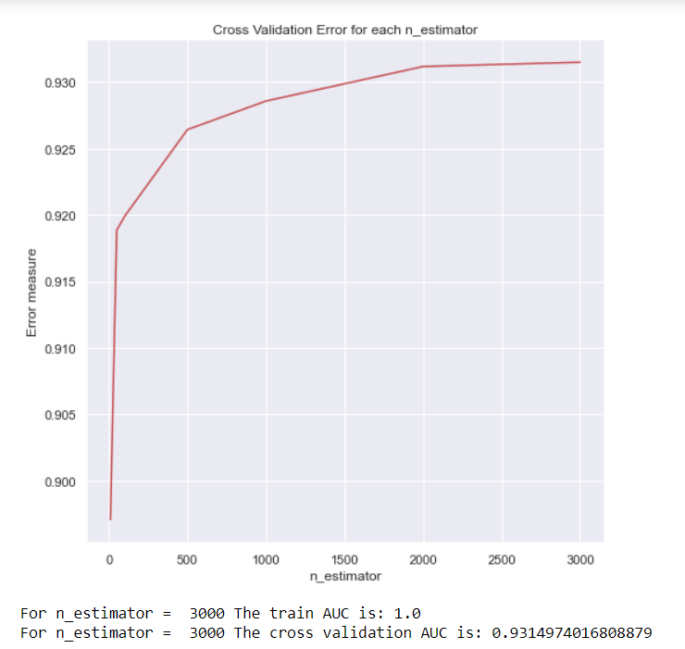
OUTCOME
The best choice of ‘n_estimators’ used in our most optimized Random Forest Classification model architecture is n_estimators = 3000
The AUC score on the cross validation set is 0.9315

Slide 52
XGBoost
We also attempted tackling the problem with XGboost classifier. Gradient boosting builds an additive model in a forward stage-wise fashion; it allows for the optimization of arbitrary differentiable loss functions
XGBoost provides a wrapper class to allow models to be treated like classifiers or regressors in the scikit-learn framework.
We tune the hyper parameter n_estimators, which indicates the number of boosting stages to perform.

Slide 53
OUR PROCESS
STEP 2
STEP 4
STEP 1
STEP 3
STEP 5
We first iterate through all the choices of hyperparameter ‘n_estimators’. We train our model using XGBClassifier for each choice of ‘n_estimators’ and fit the training set with our model.
We predict ROC AUC score for each calibrated classifier and choose the value of ‘n_estimators’ that gives the largest ROC AUC score.
Choice of n_estimators = [10,50,100,500,1000,2000]]
We calibrate the model using CalibratedClassifier with sigmoid method of calibration. Then for each of these calibrated models corresponding to our choice of ‘n_estimators’, we predict the probabilities of output variable ‘y’.
We train our model again using the best value of ‘n_estimators’ and predict the most optimal probabilities of output variable ‘y’.

Slide 54
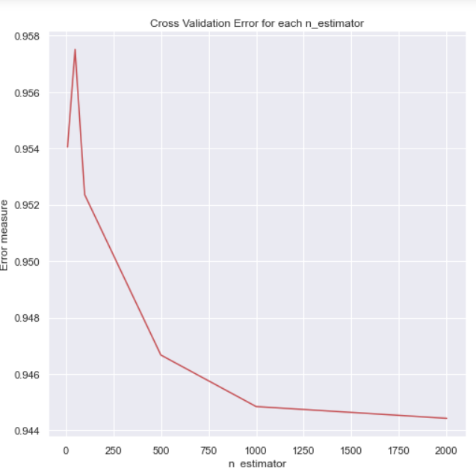
OUTCOME
The best choice of ‘n_estimators’ used in our most optimized XGBoost Classification model architecture is n_estimators = 50
The AUC score on the cross validation set is 0.9575

Slide 55
XGBoost with RandomisedSearchCV
RandomizedSearchCV implements a randomized search over parameters, where each setting is sampled from a distribution over possible parameter values.
We perform hyperparameter optimization by objectively searching different values for model hyperparameters and choose a subset that results in a model that achieves the best performance on the given dataset.
We tune the hyper parameters =
[‘n_estimators’, ‘learning_rate’,’max_depth’,'colsample_bytree','subsample'].

Slide 56
OUR PROCESS
STEP 2
STEP 4
STEP 1
STEP 3
STEP 5
We train our model using XGBClassifier passing the params we found using randomized search. The already trained model is calibrated using CalibratedClassifier.
We create a RandomizedSearchCV model with our choice of parameters. We fit the model to the training encoded dataset.
Choice of parameters = {
'Learning_rate' : [0.01,0.03,0.05,0.1,0.15,0.2],
'N_estimators' : [100,200,500,1000,2000],
'Max_depth' : [3,5,10],
'Colsample_bytree' : [0.1,0.3,0.5,1],
'Subsample' : [0.1,0.3,0.5,1]}
We then predict the most optimal probabilities of output variable ‘y’. And calculate the cross validation AUC score.
We check for 20 iterations, and choose the params that output highest ROC AUC score.

Slide 57
OUTCOME
The best choice of params = {'subsample': 0.1, 'n_estimators': 100, 'max_depth': 3, 'learning_rate': 0.05, 'colsample_bytree': 0.5}
The AUC score on the cross validation set is 0.9564.

Slide 58
LightGBM
Light GBM is a gradient boosting algorithm that grows tree leaf-wise. It will choose the leaf with max delta loss to grow. When growing the same leaf, Leaf-wise algorithm can reduce more loss than a level-wise algorithm. It can handle large size of data and takes lower memory to run.
The primary benefit of the LightGBM is the changes to the training algorithm that make the process dramatically faster, and in many cases, result in a more effective model.
We tune the hyper parameter n_estimator which indicates the number of boosted trees to fit.

Slide 59
OUR PROCESS
STEP 2
STEP 4
STEP 1
STEP 3
STEP 5
We first iterate through all the choices of hyperparameter ‘n_estimators’. We train our model using LGBMClassifier for each choice of ‘n_estimators’ and fit the training set with our model.
We predict ROC AUC score for each calibrated classifier and choose the value of ‘n_estimators’ that gives the largest ROC AUC score.
Choice of n_estimators = [10,50,100,500,1000,2000]]
We calibrate the model using CalibratedClassifier with sigmoid method of calibration. Then for each of these calibrated models corresponding to our choice of ‘n_estimators’, we predict the probabilities of output variable ‘y’.
We train our model again using the best value of ‘n_estimators’ and predict the most optimal probabilities of output variable ‘y’.

Slide 60
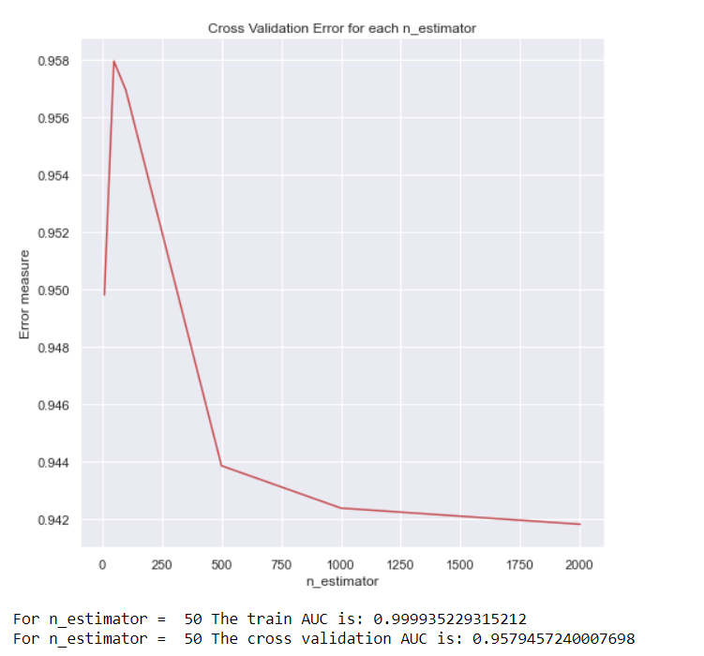
OUTCOME
The best choice of ‘n_estimators’ used in our most optimized LGBM Classification model architecture is n_estimators = 50
The AUC score on the cross validation set is 0.9579

Slide 61
CatBoost
CatBoost is based on gradient boosted trees. CatBoost is a high-performance open source library for gradient boosting on decision trees.
It is a readymade classifier in scikit-learn’s conventions terms that would deal with categorical features automatically.
We tune the hyperparameter n_estimators.

Slide 62
OUR PROCESS
STEP 2
STEP 4
STEP 1
STEP 3
STEP 5
We first iterate through all the choices of hyperparameter ‘n_estimators’. We train our model using CatBoostClassifier for each choice of ‘n_estimators’ and fit the training set with our model.
We predict ROC AUC score for each calibrated classifier and choose the value of ‘n_estimators’ that gives the largest ROC AUC score.
Choice of n_estimators = [10,50,100,500,1000,2000]]
We calibrate the model using CalibratedClassifier with sigmoid method of calibration. Then for each of these calibrated models corresponding to our choice of ‘n_estimators’, we predict the probabilities of output variable ‘y’.
We train our model again using the best value of ‘n_estimators’ and predict the most optimal probabilities of output variable ‘y’.

Slide 63
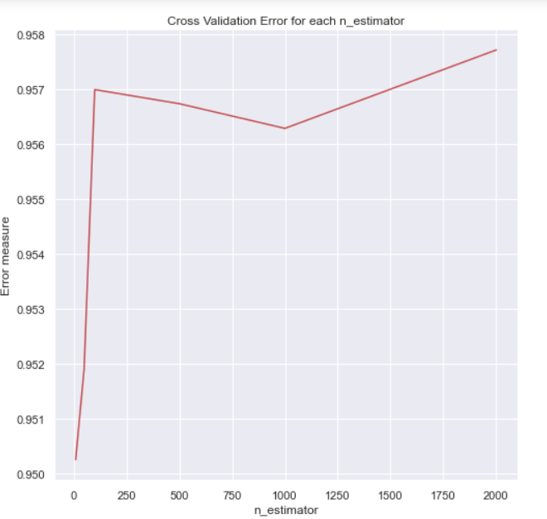
OUTCOME
The best choice of ‘n_estimators’ used in our most optimized CatBoost Classification model architecture is n_estimators = 2000
The AUC score on the cross validation set is 0.9577

Slide 64
08
COMPARATIVE STUDY

Slide 65
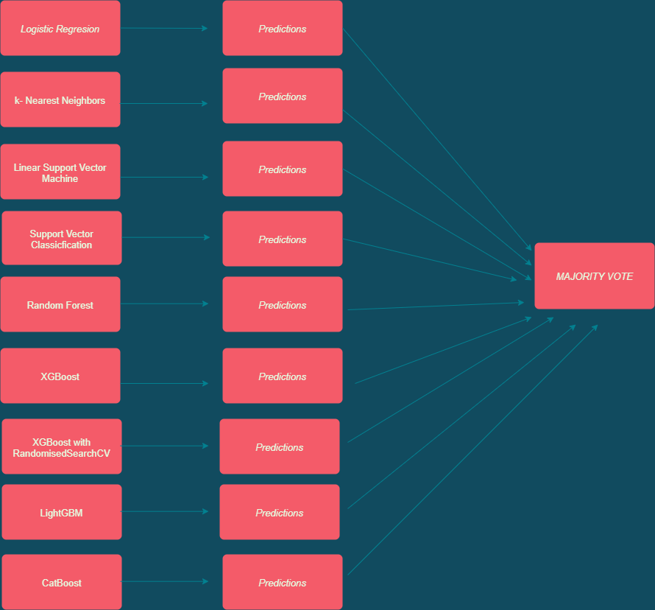
MAJORITY VOTING ENSEMBLE FLOWCHART

Slide 66
MODELS AND THEIR ACCURACIES
Model | Accuracy (AUC score on CV set)
Logistic Regression | 0.9633
K-Nearest Neighbors | 0.9620
Linear SVM | 0.9633
Support Vector Classification | 0.9635
Random Forest | 0.9315
XgBoost | 0.9575
XgBoost with RandomizedSearchCV | 0.9564
LightGBM | 0.9579
CatBoost | 0.9577

Slide 67
Tho the model with SUPPORT VECTOR CLASSIFICATION performed best on the cross validation set, however on submitting the results on Hackathon platform, XgBoost with RandomizedSearchCV outputs the best result with 0.8981 accuracy
89.97

Slide 68
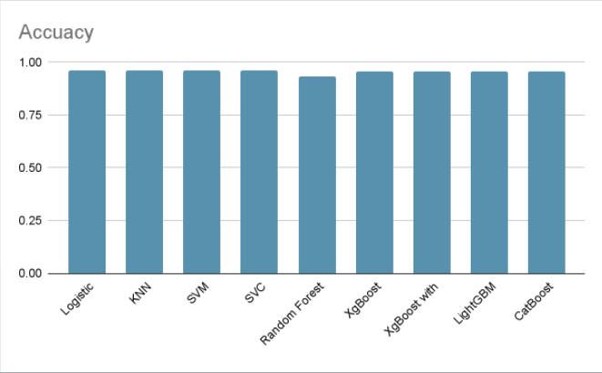
COMPARISON OF ACCURACY
Comparison of accuracies of various models

Slide 69
09
CHOICE OF MODEL

Slide 70
SUBMISSION SCORE
XgBoost | XgBoost with RandomizedSearchCV
88.26 | 89.97
After implementing all the models, we saw that the model that gave the best performance was XGBoost with RandomizedSearchCV and the submission score of 89.97.

Slide 71



OUR TEAM
Snigdha Jain
Shirin Jain
IIT Guwahati
(ECE)
Janhavi Lande
IIT Guwahati
(ECE)
IIT Guwahati
(EP)

Slide 72
THANK
YOU

